Slide 1


High Performance Cluster Computing
Architectures and Systems
Hai Jin
Internet and Cluster Computing Center

Slide 2
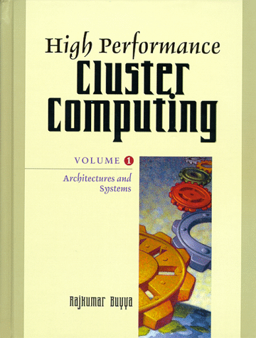
Metacomputing: Harnessing Informal Supercomputers
General Introduction
The Evolution of Metacomputing
Metacomputing Design Objectives and Issues
Metacomputing Projects
Emerging Metacomputing Environments
Summary and Conclusions

Slide 3
General Introduction
From CASA project, one of several U.S. Gigabit testbeds around 1989
Metacomputer
  a dynamic environment that has some informal pool of nodes that can join or leave the environment whenever they desire
    The nodes refer to independent machines
    A parallel computer (IBM SP2) can be viewed as a “metacomputer in a box”
    An SMP parallel computer (Tera MTA or SUN E10000) cannot
    Individual computational nodes in an SMP are not independent
  By Catlett & Smarr
    “the use of powerful computing resources transparently available to the user via a networked environment”
  a networked virtual supercomputer
  Steps to realize a metacomputer
    the integration of individual SW & HW resources into a combined networked resources
    the implementation of middleware to provide a transparent view of the resources available
    the development & optimization of distributed applications to take advantage of the resources

Slide 4
Why Do We Need Metacomputing?
Our computational needs are infinite, whereas our financial resources are finite
  users will always want more & more powerful computers
  try & utilize the potentially hundreds of thousands of computers that are interconnected in some unified way
  need seamless access to remote resources

Slide 5
What is Metacomputer?
Computational Grid
  Equivalent to metacomputing environments
  Describe a universal source of computing power
  The means to provide pervasive access to advanced computational resources, databases, sensors, and people
  Analog to electricity grid
Metacomputing encompasses
  Seamless access to high performance resources
  Parameter studies (embarrassingly parallel application)
  The linkage of scientific instruments, analysis system, archival storage, and visualization (4-way metacomputing)
  The general complex linkage of N distributed components

Slide 6
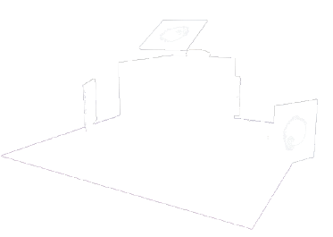
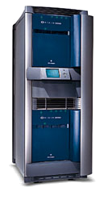

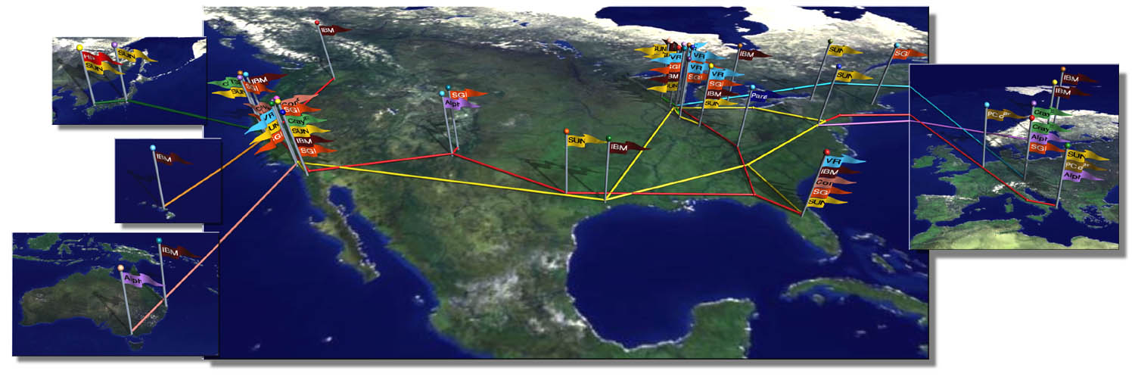
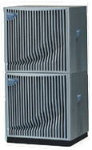


Towards Grid Computing….

Slide 7
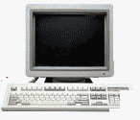

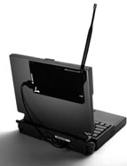

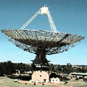



What is Grid ?
An infrastructure that couples
  Computers (PCs, workstations, clusters, traditional supercomputers, and even laptops, notebooks, mobile computers, PDA, and so on) …
  Software (e.g., renting expensive special purpose applications on demand)
  Databases (e.g., transparent access to human genome database)
  Special Instruments (e.g., radio telescope--SETI@Home Searching for Life in galaxy, Austrophysics@Swinburne for pulsars)
  People (may be even animals who knows ?)
Across the Internet and presents them as an unified integrated (single) resource

Slide 8
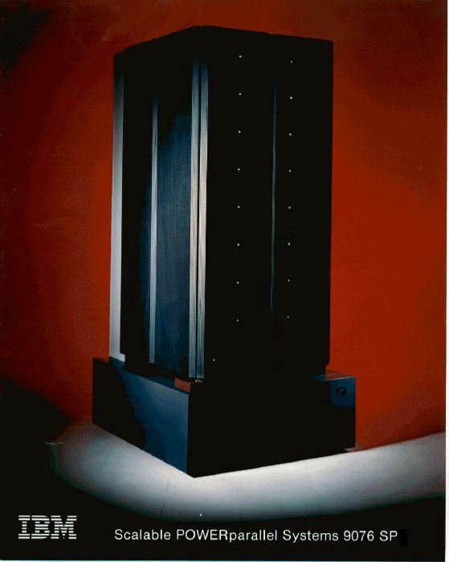
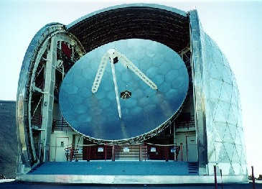
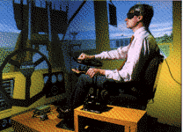
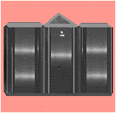
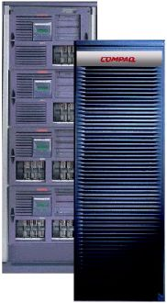
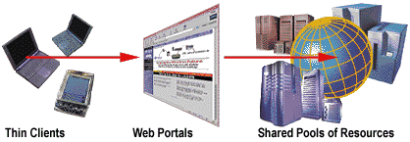
Conceptual view of the Grid
Leading to Portal (Super)Computing

Slide 9
Grid Application-Drivers
Old and new applications getting enabled due to coupling of computers, databases, instruments, people, etc.
  (distributed) Supercomputing
  Collaborative engineering
  High-throughput computing
    large scale simulation & parameter studies
  Remote software access / Renting Software
  Data-intensive computing
  On-demand computing

Slide 10
The Grid Impact
“The global computational grid is expected to drive the economy of the 21st century similar to the electric power grid that drove the economy of the 20th century”

Slide 11
The Parts of a Metacomputer
A metacomputer
  A virtual computer architecture
  Its constituent components are individually not important
  The key concept is how these components work together as a unified resources
  Components
    Processors and Memory
      An array of processors with some dynamic memory associated
    Networks and Communications Software
      Physical connections and some communications software
    Virtual Environment
      Configure, manage, and maintain the metacomputing environment like an OS
    Remote Data Access and Retrieval
      Interacting between supercomputers across national or international networks (a major challenge for metacomputing environment)

Slide 12
The Evolution of Metacomputing
Early examples
  FAFNER
    Running on any workstation with more than 4MB of memory
  I-WAY
    A means of unifying the resource of large supercomputing centers

Slide 13
FAFNER (I)
The RSA algorithm - combining prime numbers
  factoring is computationally very expensive
By Bellcore Labs. ,Syracus University and Co-Operating Systems in 1995
A project of factoring via the Web
Use parallel factoring algorithm (RSA130) which require no communications after the initial setup
Use a numerical technique NFS (Number Field Sieve) factoring method using computational Web servers
The consortium produced a Web interface to NFS
Server-side CGI scripts (in Perl) invoked by contributors support services for the sieving step of the factorization
Won award in TeraFlop challenge at SC95

Slide 14
FAFNER (II)
Factors for success
  The NFS implementation allowed even single workstations with 4MB to perform useful work using small bounds and a small sieve
  Support anonymous registration – users could contribute their hardware resources to the sieving effort without revealing their identity to anyone other than the local server administrator
  A consortium of sites was recruited to run the CGI script package locally, forming a hierarchical network of RSA130 Web servers which reduced the potential administrator bottleneck and allowed sieving to proceed around the clock with minimal human intervention

Slide 15
I-WAY (I)
Information Wide Area Year (I-WAY)
  an experimental high performance network linking many high performance computers & advanced visualization environment
  conceived in early 1995 with the idea not to build a network, but to integrate existing high-bandwidth networks with telephone systems
  connect 17 different U.S. sites by 10 networks
    based on ATM technology
I-POP (Point-of-Presence)
  gateways to I-WAY
  UNIX workstation
    accessible via the Internet, operated within its site’s firewall
    had an ATM interface
  I-POP provide uniform authentication, resource reservation, process creation, and communication functions across I-WAY resource

Slide 16
I-WAY (II)
I-Soft
  a standard S/W environment of I-POP
  help overcome issues such as heterogeneity, scalability, performance, and security
Computational Resource Broker (CRB)
  Resource scheduler
  Consist user-to-CRB and CRB-to-local-scheduler protocols
  A single central scheduler and multiple local scheduler daemons (one per I-POP)
    Central scheduler maintain queues of jobs and tables representing the state of local machines, allocating jobs to machine and maintaining state information on the AFS file system
  Authentication proxy, performing subsequent authentication to I-WAY resource on a user’s behalf
    Kerberos authentication and encryption

Slide 17
I-WAY (III)
AFS
  Provide a shared file repository for software and scheduler information
  A version of remote copy (ircp) to move data between machines
Nexus
  Low-level communication library
  Support automatic configuration mechanism to choose appropriate configuration depending on the technology used
Application driven
  Supercomputer – Supercomputing
  Remote Resource – Virtual Reality
  Virtual Reality- Virtual Reality
  Multisupercomputer – Multivirtual Reality
  Video, Web, GII-Windows

Slide 18
Summary of FAFNER and I-WAY
FAFNER
  Forerunner of projects such as WebFlow
  Work on any platform where a Web server could be run
  Tailored to a particular factoring application that was in itself trivially parallel and was not dependent on a fast interconnect
  Dependent on quite a lot of human intervention to distribute and collect sieving results
  Lack of a number of features
    Every client had to compile, link, and run a FAFNER daemon
    Individual computational tasks were unable to communicate with one another
I-WAY
  I-soft was very influential on the approach used to design components employed in the Globus toolkit
  Unify the resource at supercomputing sites
  Cope with a range of diverse high performance applications that typically need a fast interconnect
  Limited by the design of components that made up I-POP and I-Soft
  A number of inappropriate features
    I-POP is a single-points-of-failure

Slide 19
Metacomputer Design Objectives and Issues (I)
General Principles
  Not interfere with the existing site administration or autonomy
  Not compromise existing security of users or remote sites
  Not need to replace existing OS, network protocols, or services
  Allow remote sites to join or leave the environment whenever they choose
  Not mandate the programming paradigms, languages, tools, or libraries that a user wants
  Provide a reliable and fault tolerance infrastructure with no single point of failure
  Provide support for heterogeneous components
  Use standards, and existing technologies, and is able to interact with legacy applications
  Provide appropriate synchronization and component program linkage

Slide 20
Metacomputer Design Objectives and Issues (II)
Underlying Hardware and Software Infrastructure
  A metacomputing environment must be able to operate on top of the whole spectrum of current and emerging HW & SW technology
  An ideal environment will provide access to the available resources in a seamless manner such that physical discontinuities such as difference between platforms, network protocols, and administrative boundaries become completely transparent

Slide 21
Metacomputer Design Objectives and Issues (III)
Middleware – The Metacomputing Environment
  Administrative hierarchy
    the way that each metacomputing environment divides itself up to cope with a potentially global extent
  Communication services
    needs to support protocols that are used for bulk-data transport, streaming data, group communications, and those used by distributed objects
  Directory/registration services
    provide the mechanism for registering and obtaining information about the metacomputer structure, resources, services, and status
  Processes, threads, and concurrency control
    share data and maintain consistency when multiple processes or threads have concurrent access to it

Slide 22
Metacomputer Design Objectives and Issues (IV)
Middleware – The Metacomputing Environment
  Time and clocks
    time is an entity that we wish to measure accurately
    algorithms have been developed that depends on clock synchronization
    use for maintaining the consistency of distributed data or as a part of the Kerberos authentication protocol
  Naming services
    provide an uniform name space across the complex metacomputing environment
      X.500, DNS naming schemes
  Distributed file systems and caching
    provide an uniform global namespace
    support a range of file I/O protocols
    require little or no program modification
    provide means that enable performance optimization to be implemented

Slide 23
Metacomputer Design Objectives and Issues (V)
Middleware – The Metacomputing Environment
  Security and authorization
    confidentiality: prevent disclosure of data
    integrity: prevent tampering with data
    authorization: verify identity
    accountability: knowing whom to blame
  System status and fault tolerance
  Resource management and scheduling
    efficiently and effectively schedule the applications that need to utilize the available resource in the metacomputing environment

Slide 24
Metacomputer Design Objectives and Issues (VI)
Middleware – The Metacomputing Environment
  Programming tools and paradigms
    include interface, APIs, and conversion tools so as to provide a rich development environment
    support a range of programming paradigms
    a suite of numerical and other commonly used libraries should be available
  User and administrative GUI
    intuitive and easy to use interface to the services and resources available
  Availability
    easily port on to a range of commonly used platforms, or use technologies that enable it to be platform neutral

Slide 25
Metacomputing Projects
Globus (from Argonne National Laboratory)
  provides a toolkit on a set of existing components to build metacomputing environments
Legion (from the University of Virginia)
  provides a high-level unified object model out of new and existing components to build a metasystem
Webflow (from Syracuse University)
  provides a Web-based metacomputing environment

Slide 26
Globus (I)
A computational grid
  A hardware and software infrastructure to provide dependable, consistent, and pervasive access to high-end computational capabilities, despite the geographical distribution of both resources and users
A layered architecture
  high-level global services are built upon essential low-level core local services
Globus Metacomputing Toolkit (GMT)
  a central element of the Globus system
  defines the basic services and capabilities required to construct a computational grid
  consists of a set of components that implement basic services
  provides a bag of services
  only possible when the services are distinct and have well-defined interfaces (API)

Slide 27
Globus (II)
The GMT consists of the followings
  Resources allocation and process management (GRAM)
  Unicast and multicast communications services (Nexus)
  Authentication and related security services (GSI)
  Distributed access to structure and state information (MDS)
  Monitoring of health and status of system components (HBM)
  Remote access to data via sequential and parallel interfaces (GASS)
  Construction, caching, and location of executables (GEM)

Slide 28
Globus (III)
Administrative hierarchy
  no obvious administrative hierarchy
Communication services
  Nexus
    Support for multimethod communication
    Provide an application a single relatively low-level communication API to support a wide range of high-level communication protocol characteristics
Directory/registration services
  Globus Metacomputing Directory Service (MDS)
    Provide static and dynamic information about the status of Globus system components
    Use Lightweight Directory Access Protocol (LDAP) server to store metacomputing-specific objects
    House information pertaining to the potential computing resource, their specifications, and their current availability

Slide 29
Globus (IV)
Processes, threads, and concurrency control
  Work at process level
  Nexus API can be used to construct communication primitive between threads
  No concurrency control
Time and clocks
  No particular time service
Naming services
  Use of LDAP, DNS and X.500
Security and authorization
  Generic Security Service API (GSI) using an implementation of Secure Sockets Layer and X509 certificate as authentication system
  Use RSA encryption algorithm and associated public and private keys

Slide 30
Globus (V)
Distributed file systems and caching
  Global Access to Secondary Storage (GASS)
    Define a global name space via URLs
    Provide basic access to remote files via standard I/O interface
    File cache is used to address bandwidth management issues associated with repeated access to remote files
    A simple locking protocol for local concurrency control, not implement a wide-area cache coherency mechanism
  Remote I/O (RIO)
    A distributed implementation of MPI-IO, parallel I/O API
  Globus Executable Management (GEM)
    Enable loading and executing a remote file through GRAM using GASS caching calls

Slide 31
Globus (VI)
System status and fault tolerance
  Detection of a fault is a necessary prerequisite to fault recovery and fault tolerance
  Heartbeat monitor (HBM) as fault detection service
  Nexus communication library support for fault detection
Resource management and scheduling
  Globus Resource Allocation Manager (GRAM)
    Allow jobs to run remotely and provide an API for submitting, monitoring, and terminating jobs
    Provide local component for resource management
    GRAM is responsible for
      Parsing and processing the Resource Specific Language (RSL) specifications that outline job requests
      Enabling remote monitoring and managing of jobs already created
      Updating MDS with information regarding the availability of the resource it manages

Slide 32
Globus (VII)
Programming tools and paradigms
  Support MPI, Java, Compositional C++, Simple RPC, Perl
User and administrative GUI
  Use Web and command line interface
Availability
  Available on most version of UNIX

Slide 33
Legion (I)
An object-based metasystem
Organized by classes and metaclasses
  Every thing is an object
  Classes manage their instances
  Users can define their own classes
  Core objects
Core objects
  Classes and Metaclasses, Host objects, Vault objects, Binding Agents
  Implementation Objects and Caches, Context objects and Context spaces

Slide 34
Legion (II)
Interface Definition Language (IDL)
  The set of methods of an object describes its interface
Two state of Legion object
  active: run as a process that is accept function invocations.
  inert: the object which resides on some stable storage (OPR)
Three-tiered naming system
  Users refer to objects using human-readable strings, called context names
  Context objects map context names to LOIDs which are location-independent identifier that include an RSA public key
  A LOID is mapped to an LOA

Slide 35
WebFlow (I)
A computational extension of the Web model
  can act as a framework for the wide-area distributed computing and metacomputing
The main goal
  build a seamless framework for publishing and reusing computational modules on the Web
Three-tier Java-based architecture
The high performance backend tier is implemented using the Globus toolkit .
  MDS, GRAM, GASS
A high level, visual user interface and job broker for Globus

Slide 36
WebFlow (II)
The Management Infrastructure - by three servelets
    Session Manager
    Module Manager
    Connection Manager
  use URL addresses
  offer dynamic information about their services and current state
  communicate with each other via sockets

Slide 37
Metacomputing Functionality Matrix
Design Objective | Globus | Legion | Webflow
Admin. Hierarchy | Peer | Peer | Peer
Comm. Service | Nexus – Low-Level | MMPS – Socket-based | Hierarchical – Sockets+MPI
Dir/Reg. Services | MDS - LDAP | via Binding agents | MDS - LDAP
Process | Process-based | Object/process-based | Process-based
Clock | Not specified | Not specified | Not specified
Naming Services | LDAP +DNS/x.500 | Context Manger+DNS | LDAP +DNS
Filesystems & Caching | GASS+ROMIO | Custom Legion filesystem | GASS
Security | GSI (RSA+X.509 certs) | Object-based with RSA | SSL
Fault Tolerance | Heart-beat monitor | Not available yet | None
Resource Management | GRAM+RSL+Local | Host object+Local | GRAM-based
Prog. Paradigms | Many and varied | MPL, BFS+wrappers | MPI
User Interface | GUI+command-line | GUI+command-line | Applet-based GUI
Availability | Most UNIX | Most UNIX | Most UNIX and NT

Slide 38
Emerging Metacomputing Environments
Java and the Web
  as the communications infrastructure
  Java has revolutionized the shape and characteristics of the software environments for heterogeneous distributed systems
  So the developers no longer have to focus on aspects such as portability and heterogeneity

Slide 39
Metacomputing Trends
Java
CORBA
From a relatively slow start, the development of metacomputers is accelerating fast with the advent of these new and emerging technologies
The framework of a metacomputing environment must be adaptable, malleable, and extensible, whatever technology and fashions become influential

Slide 40
The Impact of Metacomputing
Metacomputing is an infrastructure that can bond and unify globally remote and diverse resources
At some stage in the future, our computing needs will be satisfied in same pervasive and ubiquitous manner that we use the electricity power grid

Slide 41
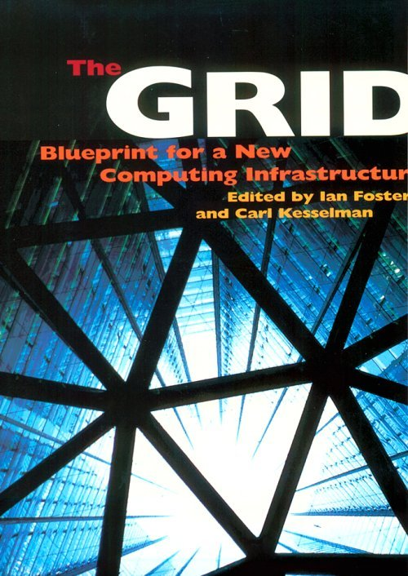
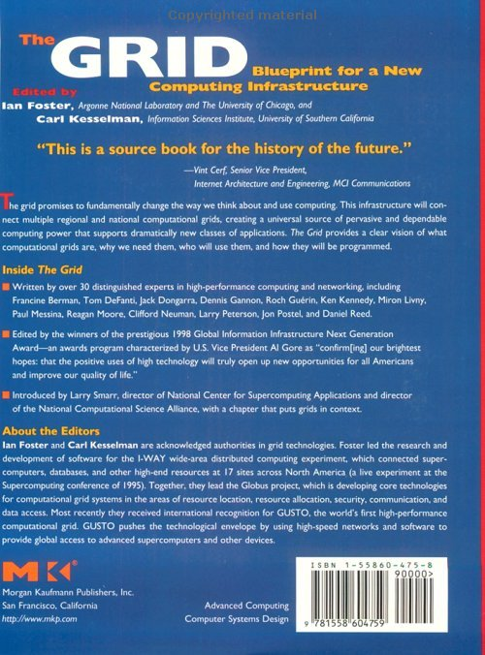
The Grid: Blueprint for a New Computing Infrastructure

